Slide 1


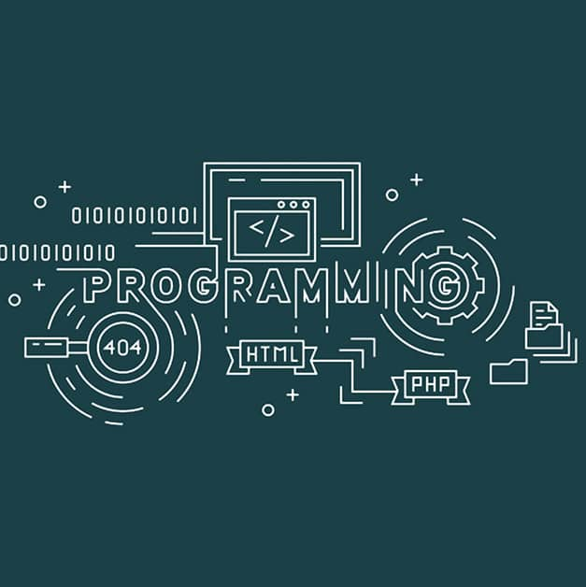
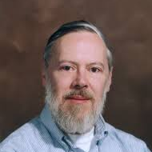

Programming and Problem Solving in C

Slide 2
Module-1: BASICS OF C PROGRAMMING :
Introduction to programming paradigms: Applications of C Language, Structure of C program
C programming: Data Types, Constants, Enumeration Constants, Keywords.
Operators: Precedence and Associativity, Expressions, Input/Output statements, Assignment statements, Decision making statements, Switch statement, Looping statements Preprocessor directives, Compilation process.

Slide 3
Module-2: ARRAYS AND STRINGS :
Introduction to Arrays: Declaration, Initialization One dimensional array Two dimensional arrays.
String operations: length, compare, concatenate, copy, Selection sort, linear and binary search.

Slide 4
Module-3: FUNCTIONS AND POINTERS :
Modular programming : Function prototype, function definition, function call, Built-in functions (string functions, math functions) Recursion, Binary Search using recursive functions.
Pointers: Pointer operators, Pointer arithmetic, Arrays and pointers, Array of pointers.
Parameter passing: Pass by value, Pass by reference.

Slide 5
Module-4: STRUCTURES AND UNION :
Structure: Nested structures, Pointer and Structures, Array of structures, Self referential structures
Dynamic memory allocation: Singly linked list, typedef
Union: Storage classes and Visibility.
Module-5: FILE PROCESSING :
Files Types of file processing: Sequential access, Random access Sequential access file - Random access file - Command line arguments.

Slide 7
Module-1:
BASICS OF C PROGRAMMING

Slide 8
What is Programming?
What is Programming Language?

Slide 9
What is Programming? : Writing a Program
What is Programming Language? : Is a Collection of Tokens.

